Slide 1



Dashboard_CallCenter
View in Power BI
Last data refresh:
21/03/2025 04:03:47 UTC
Downloaded at:
21/03/2025 04:05:21 UTC

Slide 2
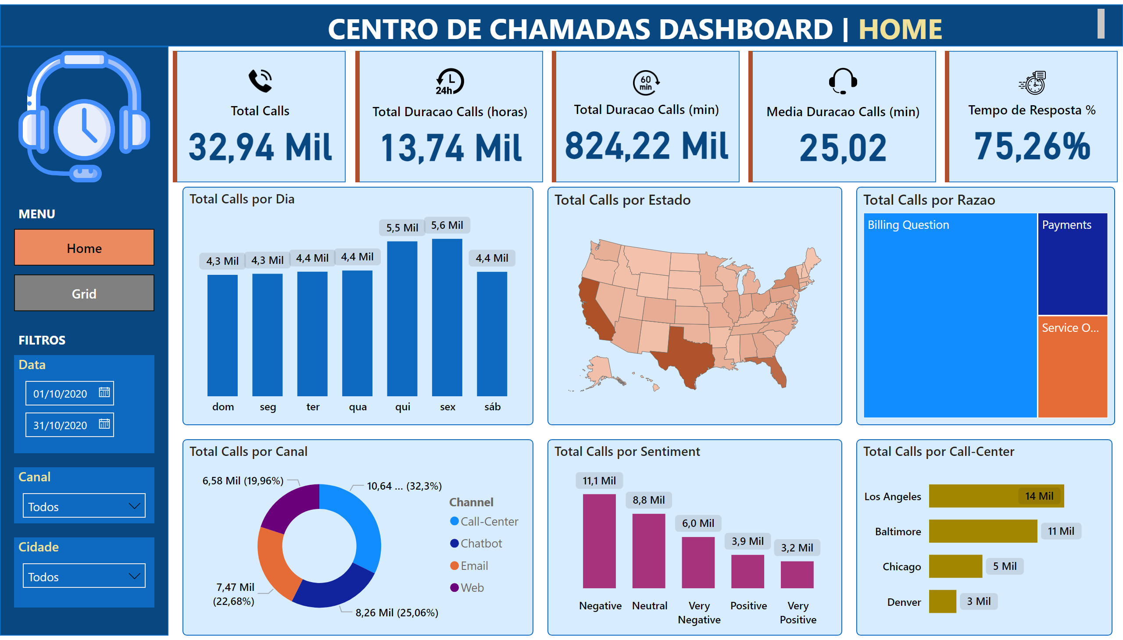
Home
Notes:
shape
No alt text provided
shape
No alt text provided
cardVisual
No alt text provided
cardVisual
No alt text provided
cardVisual
No alt text provided
cardVisual
No alt text provided
cardVisual
No alt text provided
textbox
No alt text provided
textbox
No alt text provided
clusteredColumnChart
No alt text provided
Total Calls por Estado
No alt text provided
Total Calls por Razao
No alt text provided
Total Calls por Canal
No alt text provided
columnChart
No alt text provided
barChart
No alt text provided
Data
No alt text provided
Canal
No alt text provided
Cidade
No alt text provided
image
No alt text provided
MENU
No alt text provided
textbox
No alt text provided
textbox
No alt text provided

Slide 3
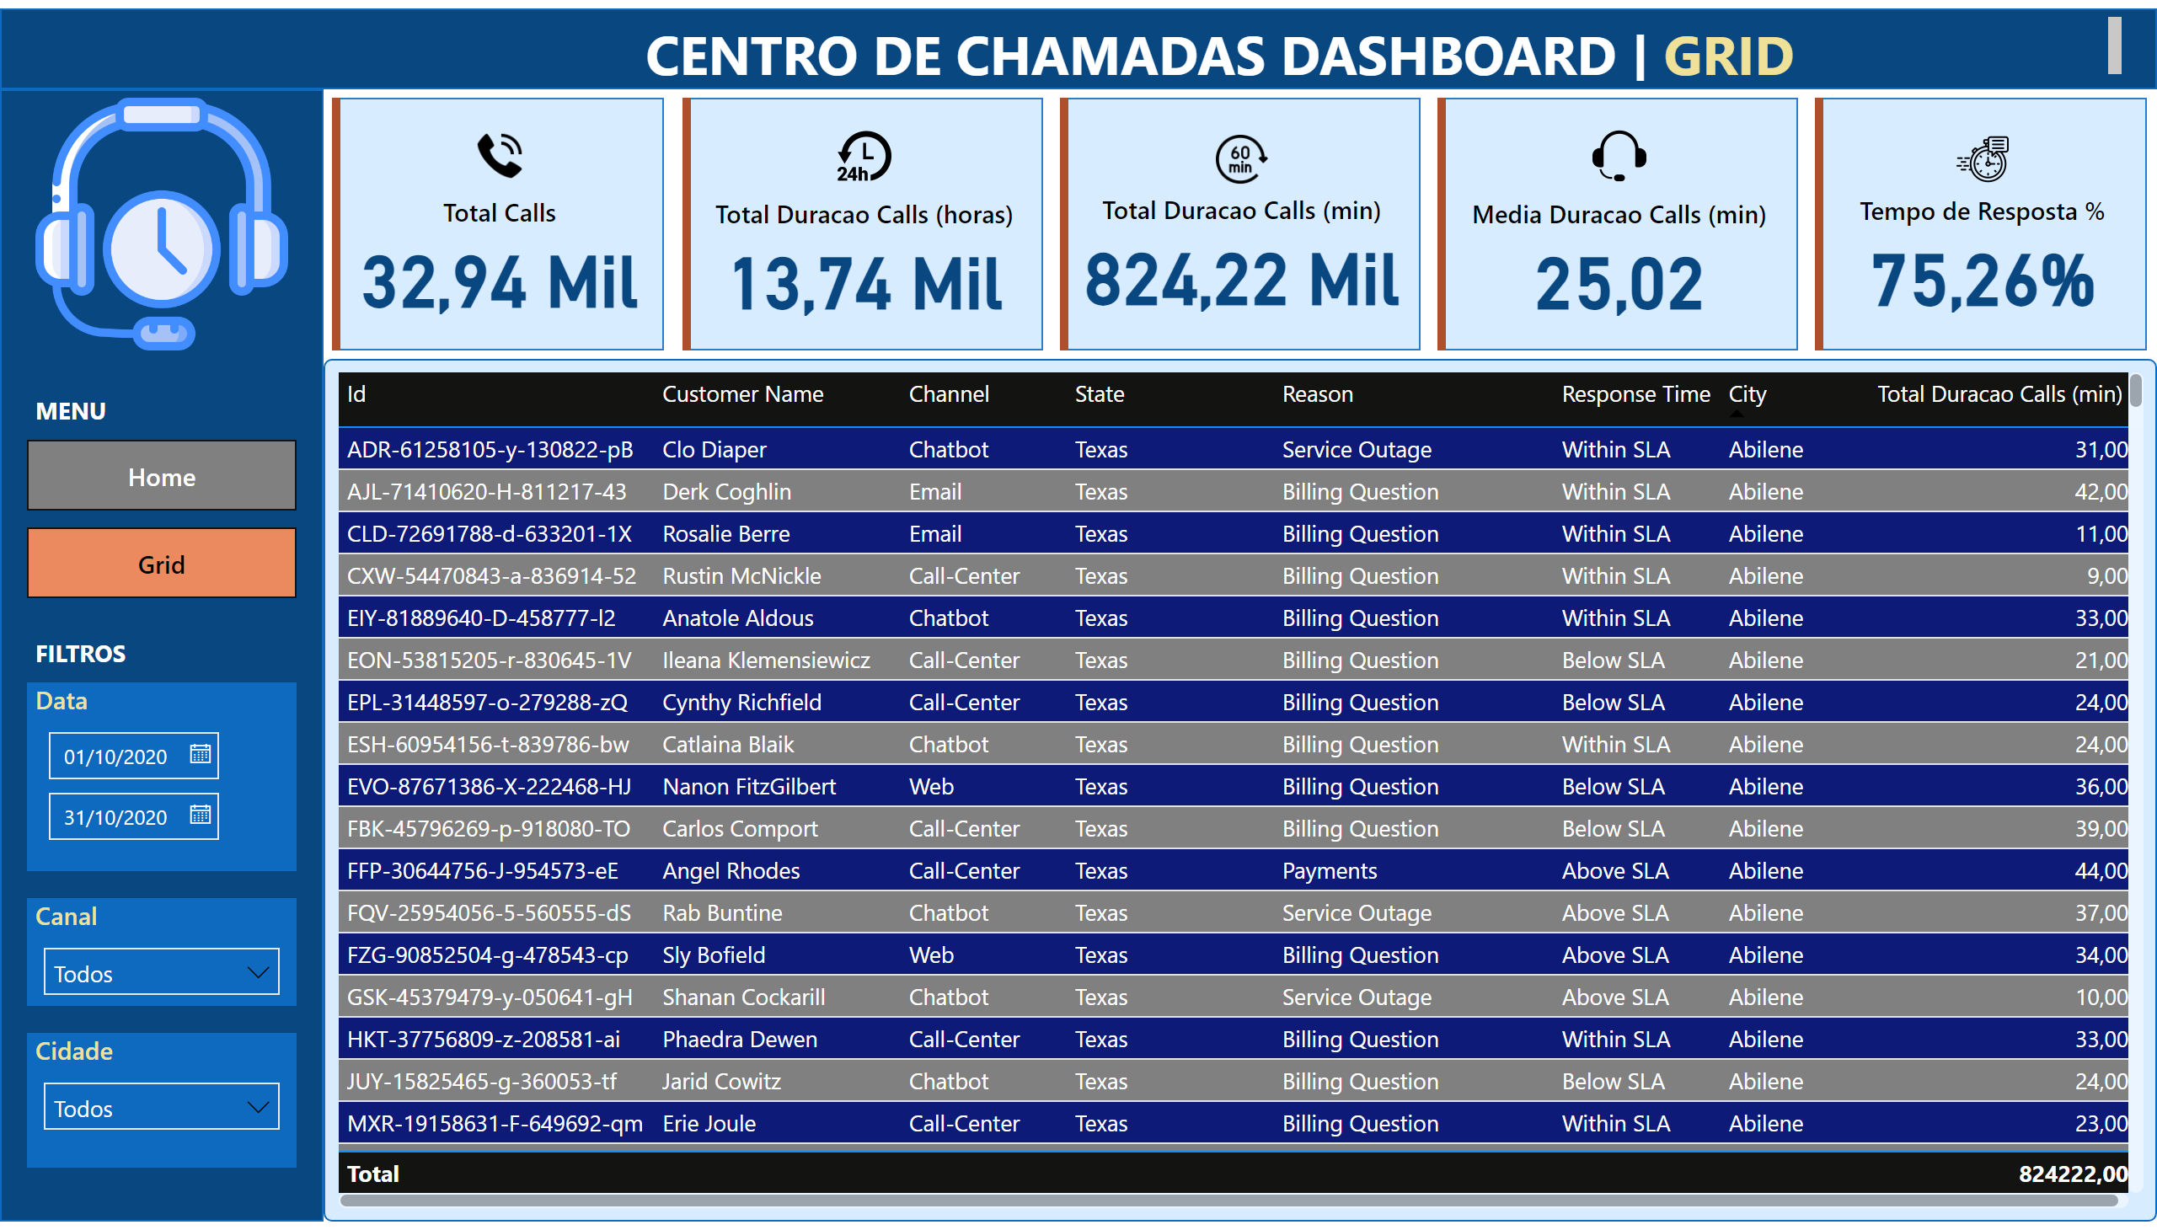
Grid
Notes:
shape
No alt text provided
shape
No alt text provided
cardVisual
No alt text provided
cardVisual
No alt text provided
cardVisual
No alt text provided
cardVisual
No alt text provided
cardVisual
No alt text provided
textbox
No alt text provided
textbox
No alt text provided
Data
No alt text provided
Canal
No alt text provided
Cidade
No alt text provided
image
No alt text provided
tableEx
No alt text provided
textbox
No alt text provided
MENU
No alt text provided
textbox
No alt text provided

